Slide 1
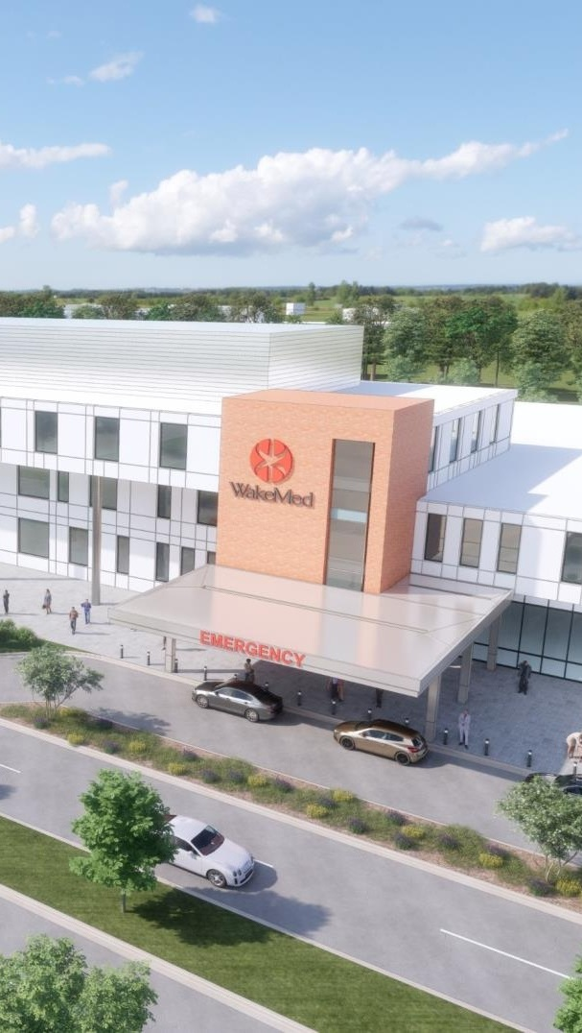


OPPORTUNITY REVIEW
DIRECT-TO-EMPLOYER GTM STRATEGY
Exploring a WakeMed Health and Hospitals DTE Health Plan

Slide 2


Founded in 1979, headquartered in Indianapolis
Largest Independently-Owned Full-Service Third-Party Administrator
Specialize in Administration of Self-Funded Plans and Population Health Management​
Leader in the Direct-to-Employer Movement
We Know and Understand the Market
Experience Working with All Professional Teams: Agents, Networks, MGAs
The Key Family of Companies is a Vertically Integrated group of benefit related organizations
3,000+ Corporate Clients
3 Million Members under Management
700 Employees

Slide 3



Our Founding and Heritage: 46 Years of Striving for Honesty in Healthcare

Slide 4
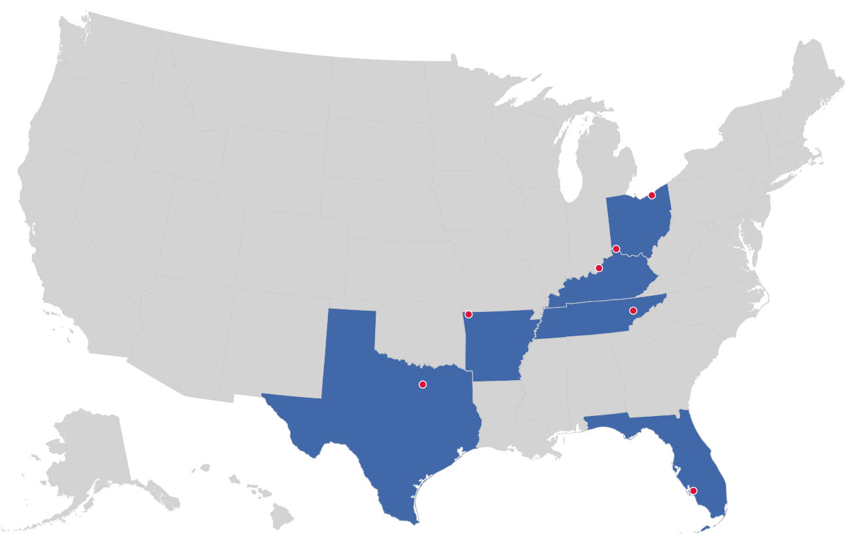

MARKET LEADER
IN
PRIVATE LABELED
DTE PLANS
Cleveland, OH
Louisville, KY
Cincinnati, OH
Bentonville, AR
Knoxville, TN
Dallas Fort Worth, TX
Fort Myers, FL

Slide 5


DIRECT-TO-EMPLOYER (DTE)
YOU Pick the Name of the Health Plan
YOU Determine the Fees Charged
YOU Practice the Medicine
YOU Receive the Profits
WE Make it Successful
Your Health Plan Focused on a Direct Relationship with Self-Funded Employers in Your Market

Slide 6
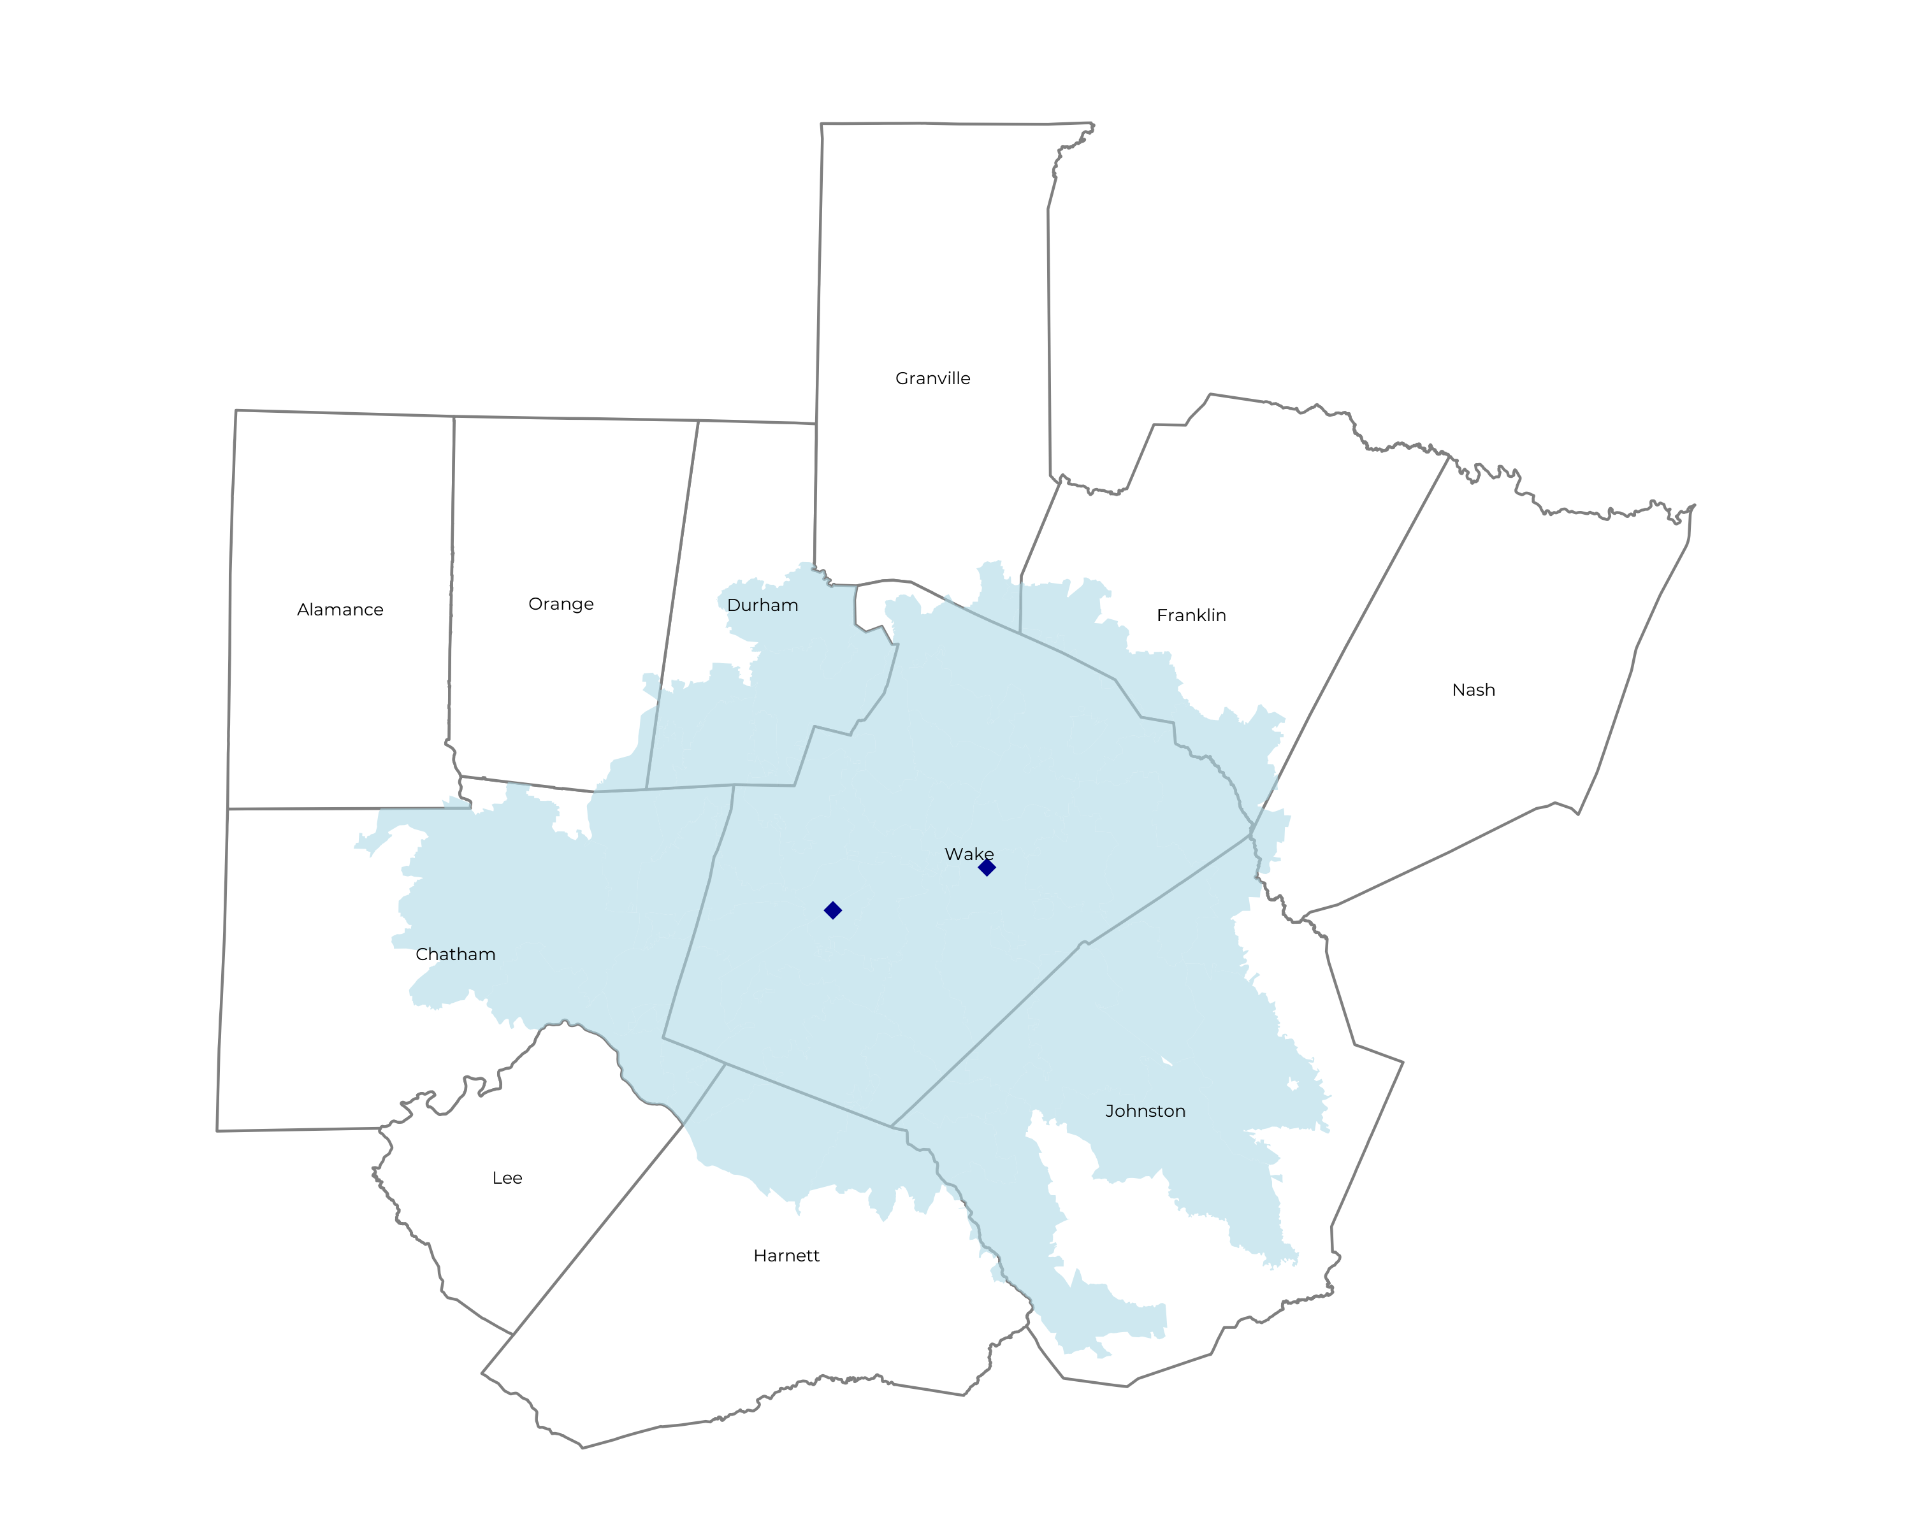
SIGNIFICANT OPPORTUNITY FOR PLAN GROWTH Researched for the below highlighted service area
Target Market 2,200+ Employers 410,000+ Employees 840,000+ Members
 | Employer Size Group (# of Employees)
Commercial Employers With Headquarters | 50-100 | 101-200 | 201-400 | 401-1,000 | 1,001-3,000 | 3,000+
In Catchment Area | 1,132 | 497 | 306 | 223 | 67 | 61
Total Employees at Employers | 50-100 | 101-200 | 201-400 | 401-1,000 | 1,001-3,000 | 3,000+
Headquartered in Catchment Area | 84,900 | 74,600 | 91,800 | 156,100 | 134,000 | 366,000
Total Members with Employers | 50-100 | 101-200 | 201-400 | 401-1,000 | 1,001-3,000 | 3,000+
Headquartered in Catchment Area | 152,800 | 134,300 | 165,200 | 281,000 | 241,200 | 658,800

Slide 7
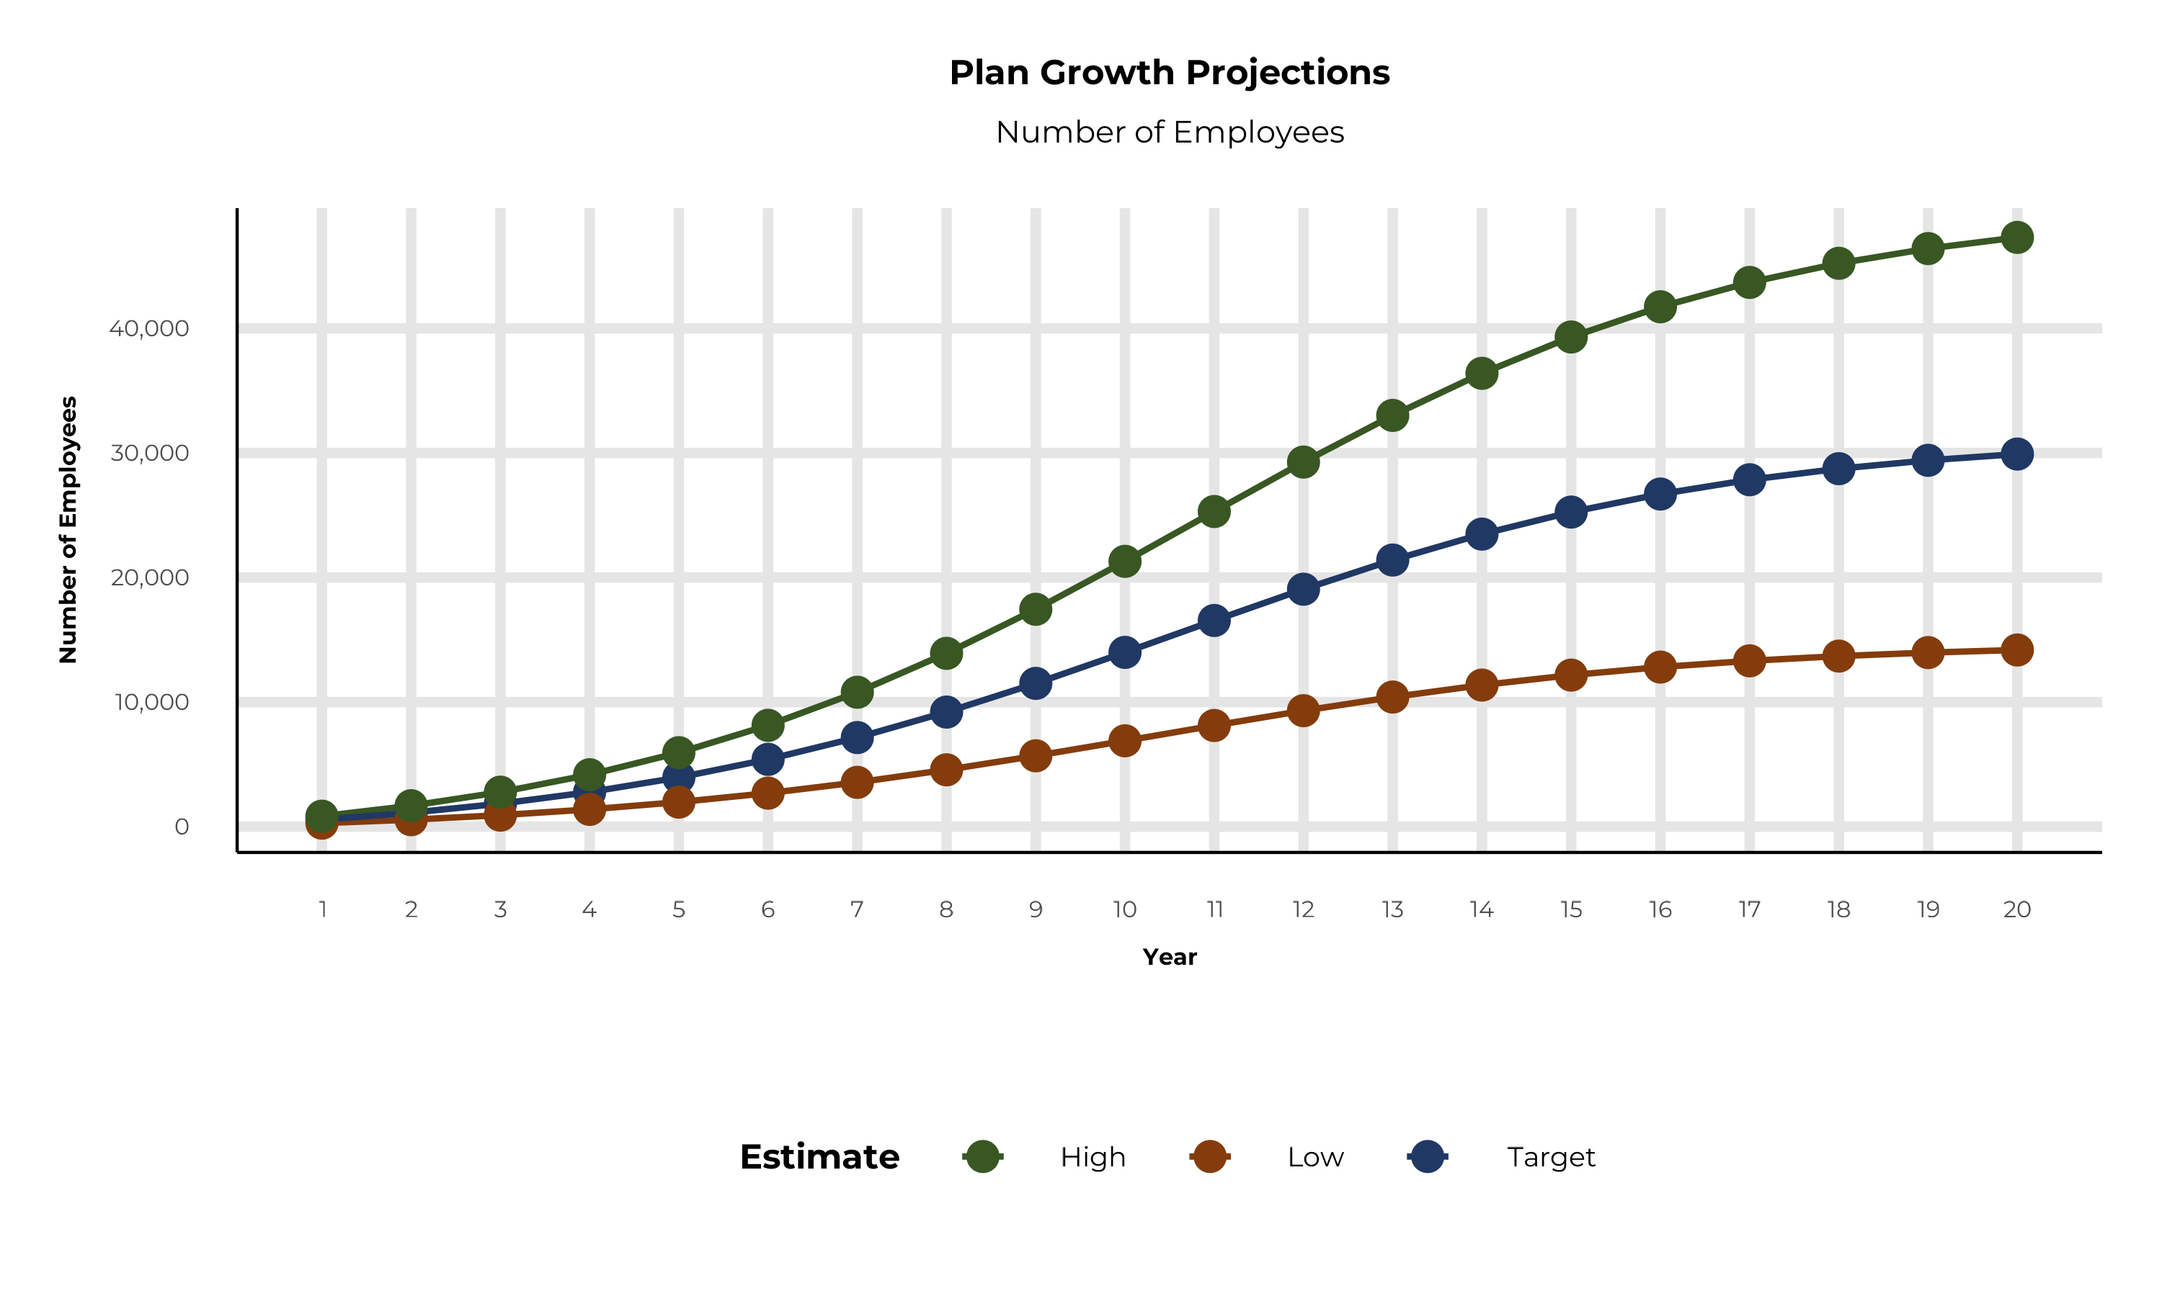
PLAN POTENTIAL GROWTH PATHS
Self Funded
410K
Insured
764K
Working Age
982K
Population
1,585K
Estimates includes the WakeMed Health and Hospitals service area in Chatham, Durham, Franklin, Harnett, Johnston, Orange, and Wake Counties

Slide 8
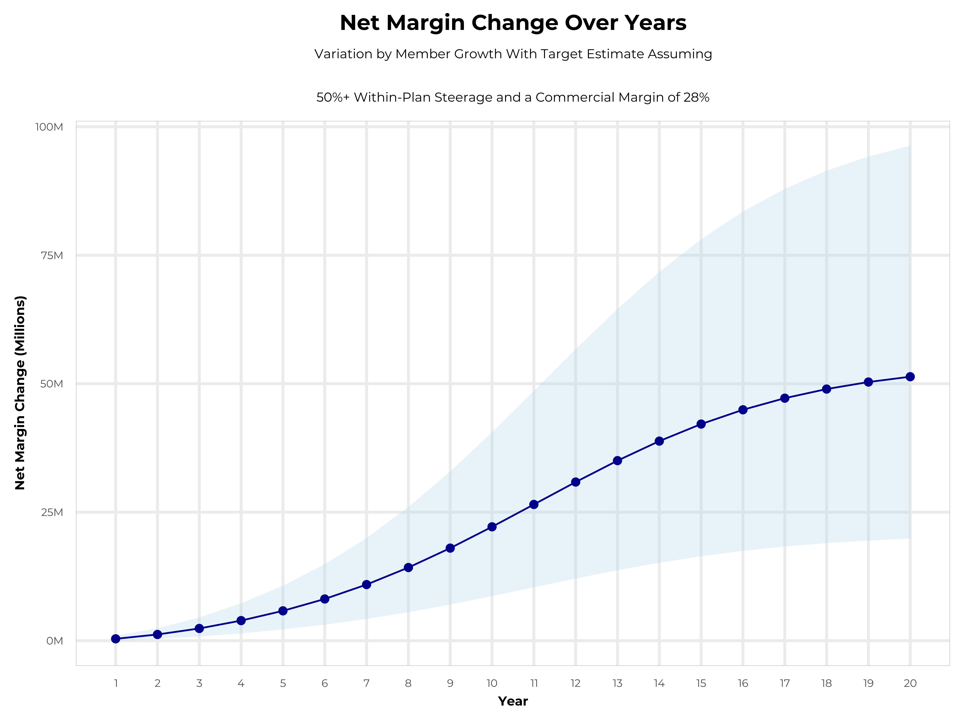
GROWING POWERFUL, LASTING PROFITABILITY
Early Stage
Gaining Name Recognition, Early Growth
New Revenue:
New Profit:
$13.47M
$3.63M
Growth Stage
Strong Reputation, Strong Growth
New Revenue:
New Profit:
$79.91M
$22.53M
Mature Stage
High Profitability, Market Saturation
New Revenue:
New Profit:
$163.48M
$46.25M

Slide 9
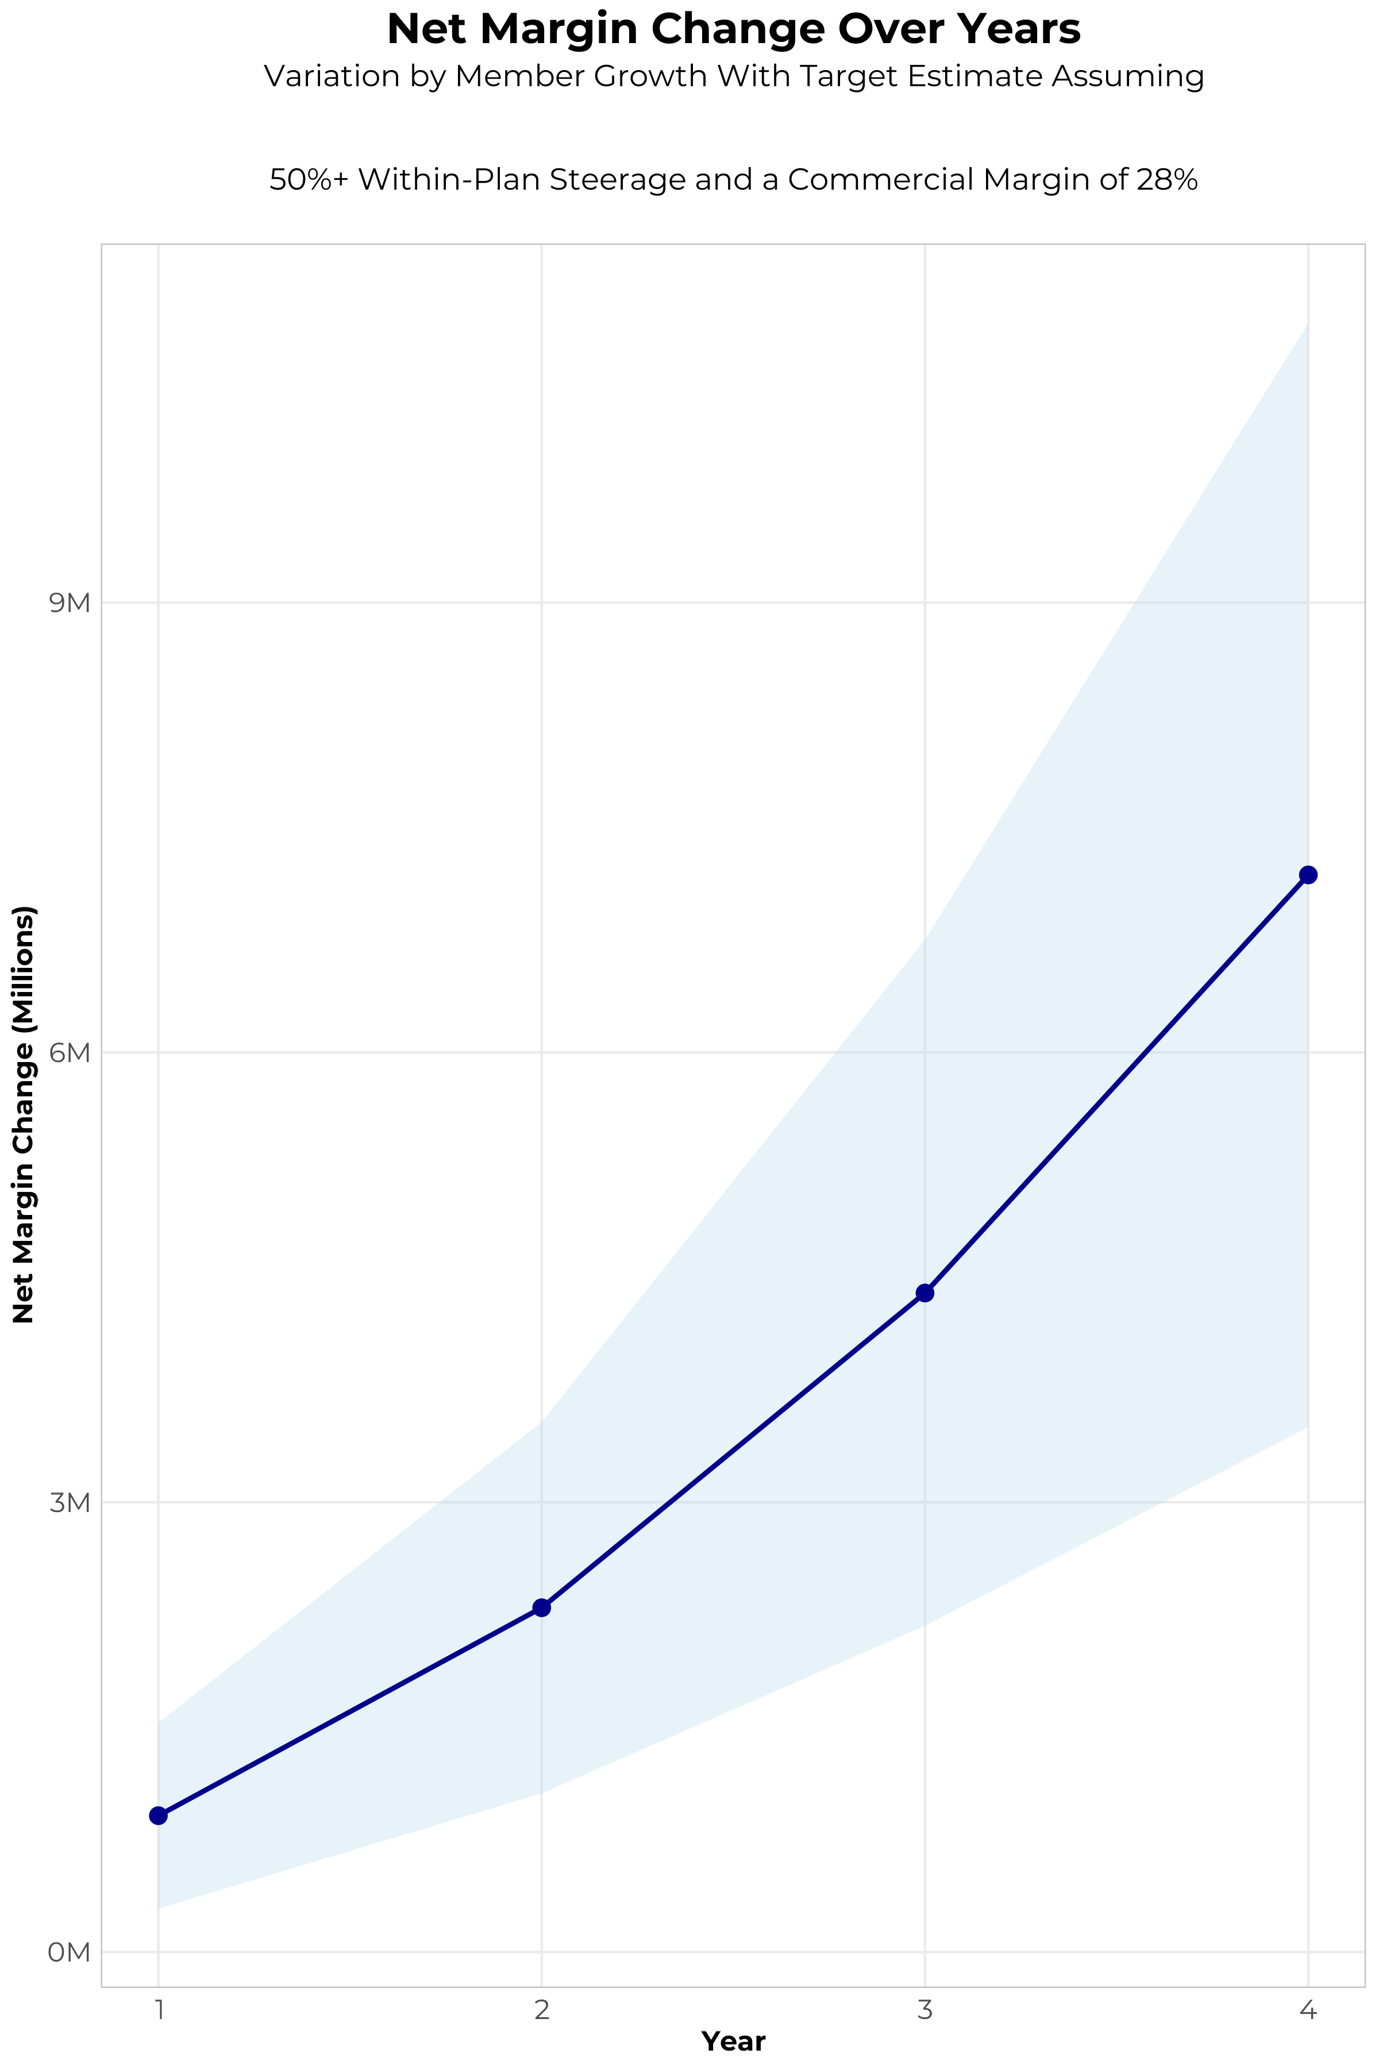
FOUR-YEAR PROJECTIONS
Target Member Growth | Target Member Growth | Target Member Growth | Target Member Growth | Target Member Growth
Metric | Year 1 | Year 2 | Year 3 | Year 4
Number of Members | 1,000 | 2,000 | 3,300 | 5,000
Incremental Margin | 1,227.6K | 2,452.4K | 4,535.8K | 7,303.9K
Network Access Fee | 12.0K | 24.0K | 39.6K | 60.0K
Implementation Fee (One-Time) | -150.0K | 0.0K | 0.0K | 0.0K
Sales and Marketing Costs | -180.0K | -180.0K | -180.0K | -180.0K
Net Margin Change | 909.6K | 2,296.4K | 4,395.4K | 7,183.9K
High Member Growth | High Member Growth | High Member Growth | High Member Growth | High Member Growth
Metric | Year 1 | Year 2 | Year 3 | Year 4
Number of Members | 1,500 | 3,000 | 5,000 | 7,500
Incremental Margin | 1,841.4K | 3,678.6K | 6,872.4K | 10,955.9K
Network Access Fee | 18.0K | 36.0K | 60.0K | 90.0K
Implementation Fee (One-Time) | -150.0K | 0.0K | 0.0K | 0.0K
Sales and Marketing Costs | -180.0K | -180.0K | -180.0K | -180.0K
Net Margin Change | 1,529.4K | 3,534.6K | 6,752.4K | 10,865.9K
Low Member Growth | Low Member Growth | Low Member Growth | Low Member Growth | Low Member Growth
Metric | Year 1 | Year 2 | Year 3 | Year 4
Number of Members | 500 | 1,000 | 1,700 | 2,500
Incremental Margin | 613.8K | 1,226.2K | 2,336.6K | 3,652.0K
Network Access Fee | 6.0K | 12.0K | 20.4K | 30.0K
Implementation Fee (One-Time) | -150.0K | 0.0K | 0.0K | 0.0K
Sales and Marketing Costs | -180.0K | -180.0K | -180.0K | -180.0K
Net Margin Change | 289.8K | 1,058.2K | 2,177.0K | 3,502.0K

Slide 10
DIRECT-TO-EMPLOYER STRATEGY: ONLY AVAILABLE TO PREMIER HEALTH SYSTEMS
STRONG Brand Quality
EXTENSIVE Patient Access
AFFORDABLE Value Pricing
EXCELLENT Care Quality

Slide 11

THE BENEFIT STEERING THE PATIENT TO WAKEMED
What Will this Claim Cost Me?
Explanation of Benefits
Heart Attack, Cardiac Surgery
THE CHARGES
Medical Bills | $25,000
Healthcare out-of-pocket due to provider | $4,500
Since your out of pocket maximum has been met, the rest of your eligible charges this year will be paid at 100%
THE CREDITS
OP Radiology/X-Ray | $200
OP Diagnostic Labs | $100
Preferred Hospital Stay ($500/day, 5 days) | $2,500
Critical Illness Benefit | $2,000
Health Screening Benefit | $125
Benefit Total | $4,925
Out of Pocket Paid to Hospital | ($4,500)
Balance Paid to HGA | $425
WakeMed Health and Hospitals patients can have all out-of-pocket liability reduced to $0!

Slide 12
PROJECTED PLAN GROWTH
Year | Employees | Members | Percent of Members Choosing WakeMed Health and Hospitals for Inpatient Care | Percent of Members Choosing WakeMed Health and Hospitals for Outpatient Care
1 | 600 | 1,100 | 60% | 50%
2 | 1,100 | 2,000 | 60% | 50%
3 | 1,800 | 3,200 | 65% | 55%
4 | 2,800 | 5,000 | 67% | 58%
5 | 3,900 | 7,000 | 68% | 60%
6 | 5,400 | 9,700 | 68% | 60%
7 | 7,200 | 13,000 | 69% | 61%
8 | 9,200 | 16,600 | 69% | 62%
9 | 11,500 | 20,700 | 69% | 62%
10 | 14,000 | 25,200 | 70% | 63%
11 | 16,600 | 29,900 | 70% | 63%
12 | 19,100 | 34,400 | 70% | 64%
13 | 21,400 | 38,500 | 71% | 64%
14 | 23,500 | 42,300 | 71% | 65%
15 | 25,300 | 45,500 | 71% | 66%
16 | 26,700 | 48,100 | 72% | 66%
17 | 27,900 | 50,200 | 72% | 66%
18 | 28,700 | 51,700 | 72% | 67%
19 | 29,400 | 52,900 | 72% | 67%
20 | 29,900 | 53,800 | 72% | 67%
KBA currently estimates that WakeMed Health and Hospitals has 24% inpatient market share, and 8% outpatient market compared to hospitals/clinics in the WakeMed Health and Hospitals service area (see slide 8).
Based on previous DTE experience, KBA expects a significant bump in patient steerage to WakeMed Health and Hospitals.
Additional steerage will occur from additional steerage patient benefits and the patient convenience card.
High estimates start nearly 10% higher than target with low estimates at 10% lower than target

Slide 13
YEAR 4 PROJECTED REVENUE AND PROFIT
Pre-DTE Cohort of 5,000 Employees | Inpatient | Outpatient | Professional | Total
Revenue† | $ 3,593,533 | $ 2,263,249 | $ 1,056,918 | $ 6,913,699
Net Income‡ | $ 1,006,189 | $ 633,709.6 | $ 295,937 | $ 1,935,836
† Assuming proportional revenues from market shares of 24% (inpatient) and 8% (outpatient)
‡ Conservatively assuming a commercial margin of 28% (80% of the estimated commercial margin)
With DTE | Inpatient | Outpatient | Professional | Total
Revenue⁰ | $ 9,933,200 | $ 15,577,267 | $ 7,274,451 | $ 32,784,918
Net Income* | $ 2,781,296 | $ 4,361,635 | $ 2,036,846 | $ 9,179,777
⁰ Assuming 67% inpatient and 58% market steerage based on KBA narrow network DTE experience (see previous slide)
* Conservatively assuming a commercial margin of 28%, with a 10 percentage-point reduction to reflect competitive-edge rates and a 10 percentage-point increase due to lower billing costs and higher patient responsibility collections because of the member convenience card.
Total Increase in Net Income | $ 7,243,941
Network Access Fee (Revenue) of $1 PMPM | $ 60,000
Total Profit Growth | $ 7,303,941
Minus Implementation Fee (One-Time) | -$ 0
Minus Sales and Marketing (Annual – Ongoing) | -$ 180,000
Total | $ 7,123,941

Slide 14





A PARTNER YOU CAN TRUST
OUR OBJECTIVES ARE ALIGNED
WE KNOW THE
MARKET
COMPLETELY TRANSPARENT
WE HAVE THE SOPHISTICATION AND INFRASTRUCTURE TO EFFECTIVELY COMPETE
Derek Moore, Senior Vice President – KBA
845-283-9973 * derek.moore@keybenefit.com

